Slide 1
Lesson 13 – Homework review

Slide 2
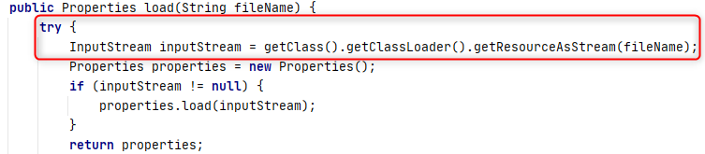
Close resources

Slide 3
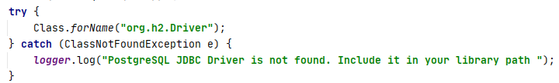
Terminate app on critical failures

Slide 4
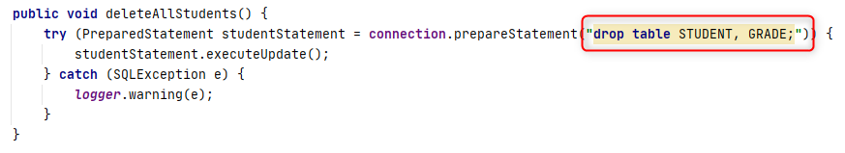
Remember about other users

Slide 5
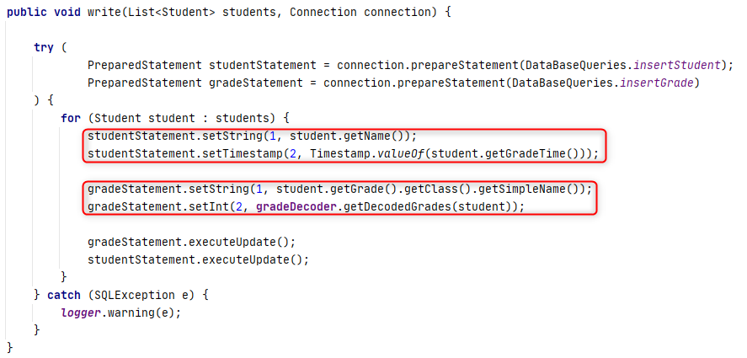
Handle transactions properly

Slide 6
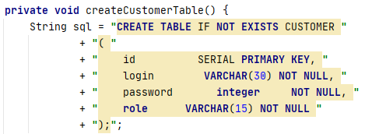
Do not do extra work

Slide 7
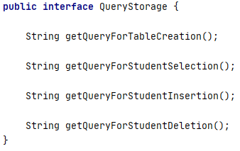
Follow SRP and Open Close

Slide 8
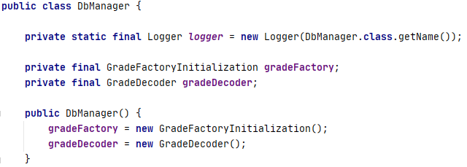
Use dependency injection

Slide 9
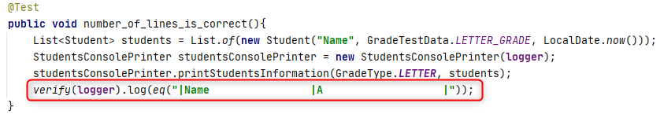
Assert result but not internal behavior

Slide 10
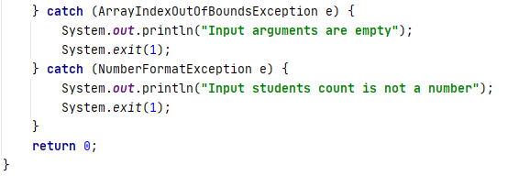
Prefer exceptions over JVM termination

Slide 11
Thanks!
Any Questions?
Or find us in Slack:
@Yaroslav Brahinets
@Vasya Rudas

